Slide 1
Akirachix
End of year party

Slide 2
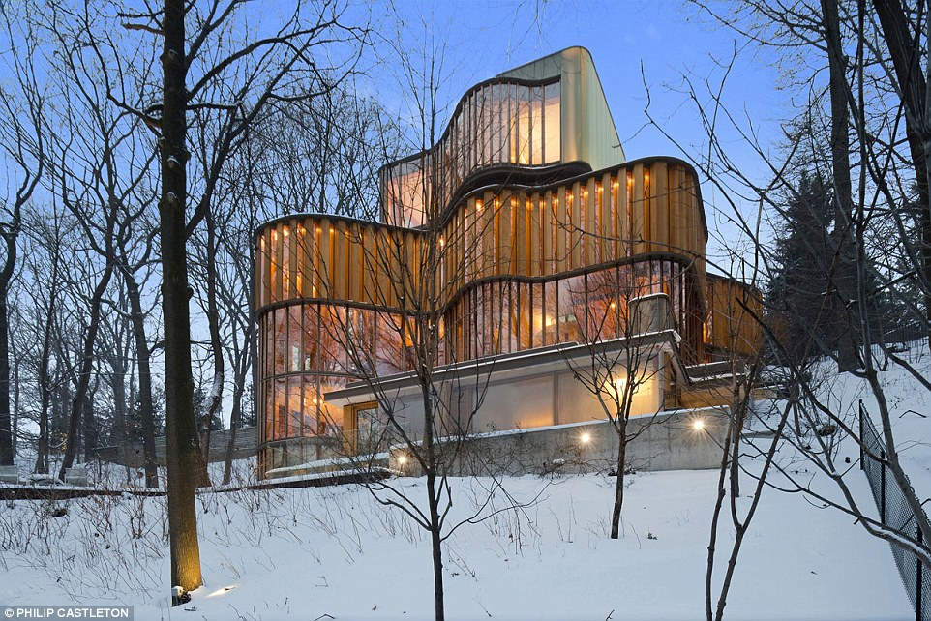
Venue : phillip castleton

Slide 3
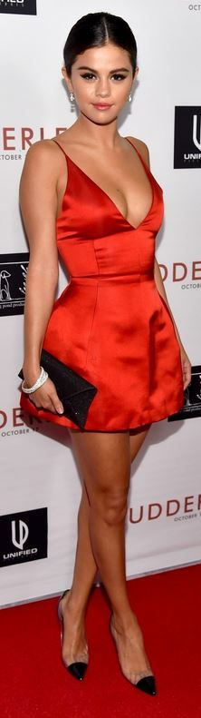

Artists present
Rihanna
Marshmello
Khalid
Selena Gomez
Mo

Slide 4
Food and drinks
Open bar
buffet

Slide 5
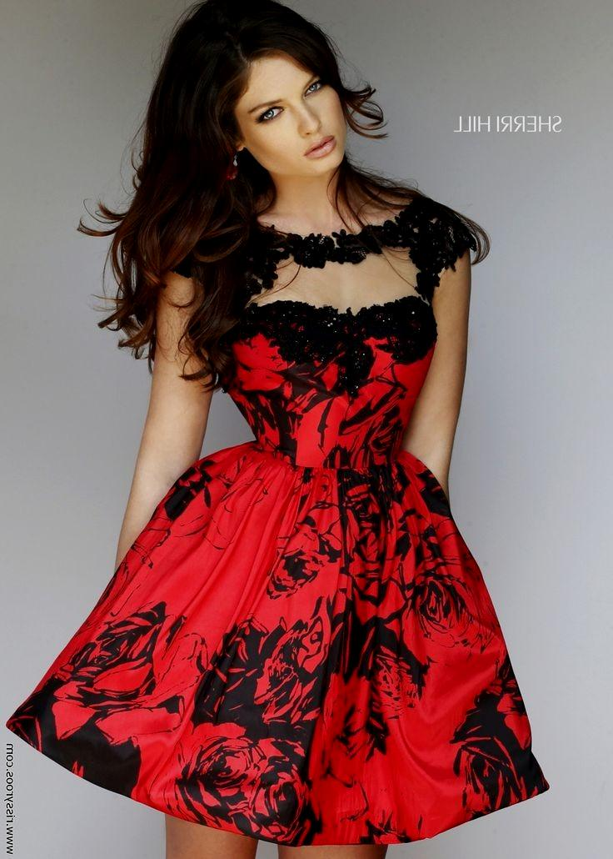
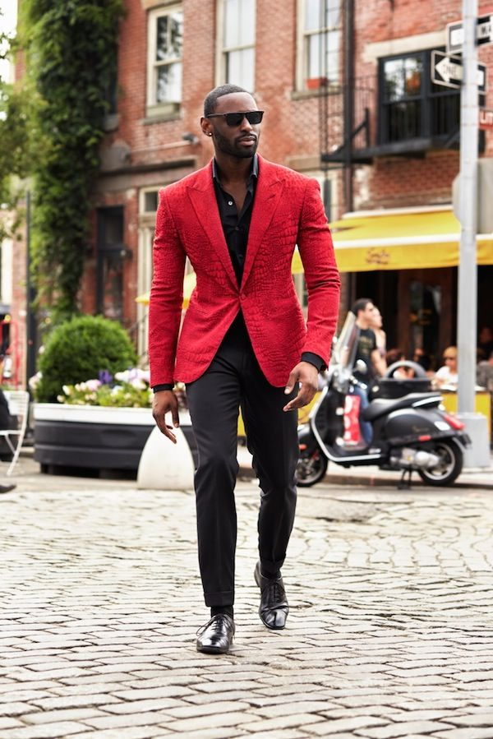
Dress code
Black and red

